Slide 1

GREEN SKILLS USING AI TECHNOLOGIES
GTU – Edunet Foundation Internship Program
Name: Vedant Patel
Enrollment No.: 241263107039
Stream: Computer Engineering
College: SAL Engineering & Technical Institute (SETI),
Ahmedabad
Date: July 2025

Slide 2


Introduction
What are Green Skills?
Definition
Green Skills are the knowledge, abilities, and practices that help protect the environment, conserve natural resources, and support sustainable development.
Why are Green Skills Important?
Protect the Environment
Reduce pollution and greenhouse gas emissions.
Create Green Jobs
Open career opportunities in renewable energy, waste management, electric vehicles, and environmental conservation.
Role of AI
AI improves waste management, predicts climate changes, optimizes energy usage, and supports sustainable agriculture.

Slide 3

Sustainable Development Goals (SDGs)
What are the SDGs?
The Sustainable Development Goals (SDGs) are 17 global goals established by the United Nations in 2015 to achieve a better and more sustainable future by 2030.
They focus on solving global challenges such as:
Climate Change
Environmental Protection
Clean Water & Sanitation
Quality Education
Reducing Inequality
Global Partnerships
What I Learned
Working together creates greater environmental impact.
AI and technology help organizations share data and solve environmental problems.
Partnerships encourage innovation and sustainable development.

Slide 4
What I Learned from the Data Centre Documentary
What is a Data Centre?
A Data Centre is a facility that stores, processes, and manages digital data. It powers cloud services, websites, AI applications, online banking, and streaming platforms.
Key Learnings
High Energy Consumption
Data centres consume large amounts of electricity to run servers 24/7.
Cooling Systems
Servers generate heat, so advanced cooling systems are required to maintain performance.
Environmental Impact
Traditional data centres can produce significant carbon emissions if powered by fossil fuels.
Role of AI
AI helps optimize cooling, monitor energy usage, predict equipment failures, and improve overall efficiency.

Slide 5
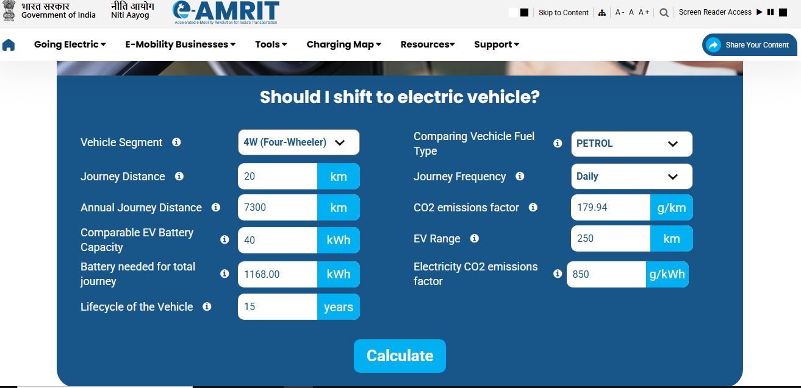
Government Website Activity – CO₂ Emission Calculator (e-AMRIT)
Vehicle Details Used :
Vehicle Type: 4W (Four-Wheeler) , Fuel: Petrol
Daily Distance: 20 km , Annual Distance: 7,300 km

Slide 6
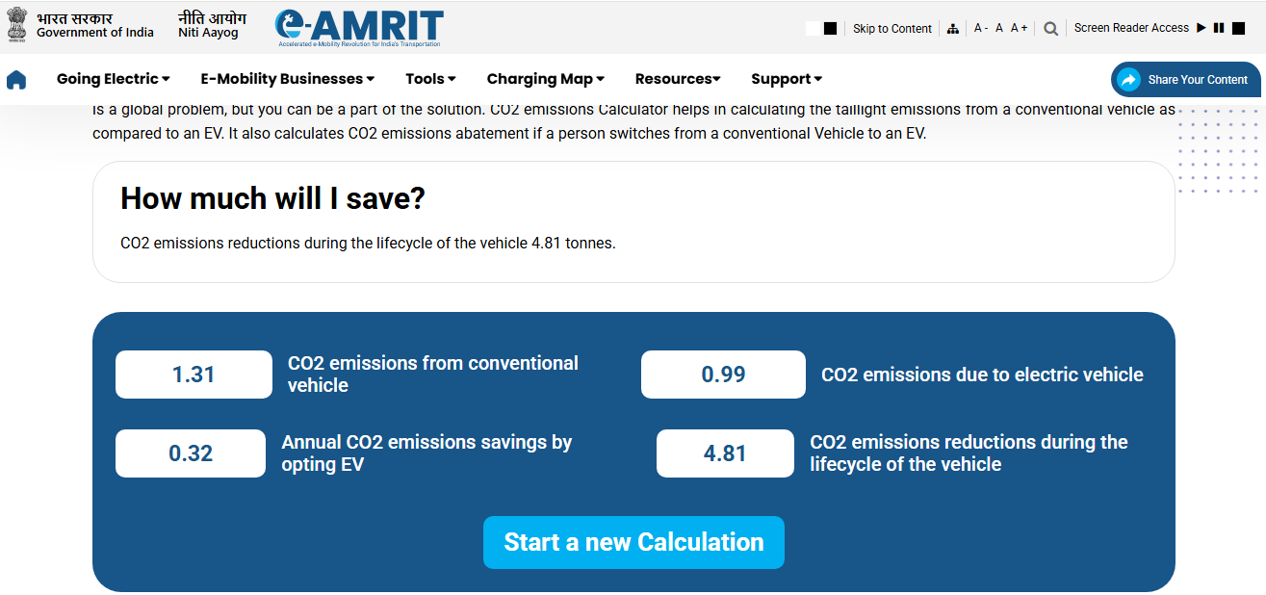
Result
Results Obtained
CO₂ emissions from conventional vehicle: 1.31 tonnes
CO₂ emissions from electric vehicle: 0.99 tonnes
Annual CO₂ savings by switching to EV: 0.32 tonnes
Total CO₂ reduction over vehicle lifetime: 4.81 tonnes

Slide 7
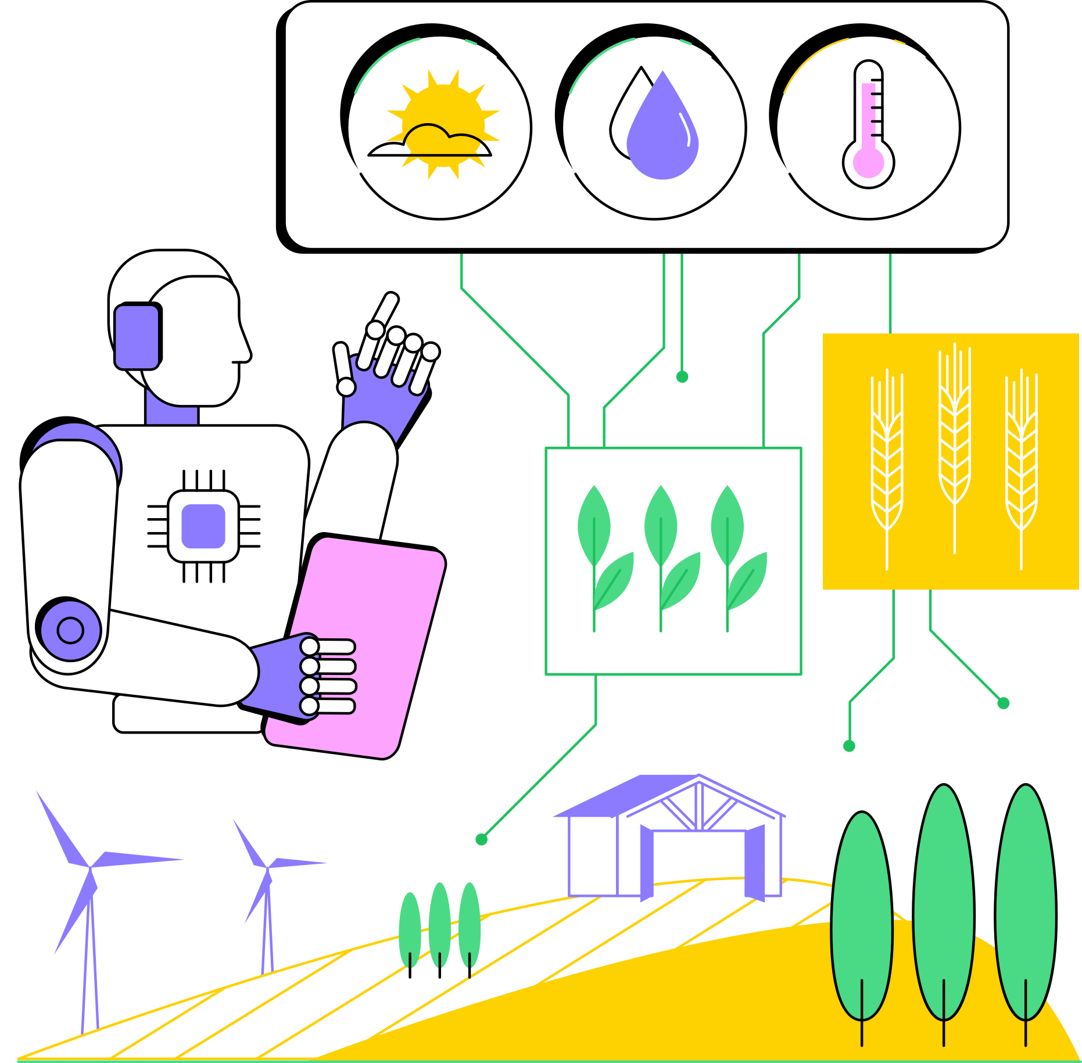
AI for Sustainability
What is AI for Sustainability?
Artificial Intelligence (AI) helps solve environmental problems by analyzing data, automating tasks, and making systems more efficient.
Applications of AI
Smart Waste Management
AI-powered smart bins automatically identify and sort waste for recycling.
Helps reduce landfill waste and improve recycling efficiency.
Smart Agriculture
AI monitors crop health, detects plant diseases, and optimizes irrigation.
Energy Management
AI predicts electricity demand and optimizes energy consumption.
Smart Transportation
AI optimizes traffic flow and promotes electric vehicle usage.

Slide 8
AI for Sustainability
What is AI for Sustainability?
Artificial Intelligence (AI) helps solve environmental problems by analyzing data, automating tasks, and making systems more efficient.
Applications of AI
Smart Waste Management
AI-powered smart bins automatically identify and sort waste for recycling.
Helps reduce landfill waste and improve recycling efficiency.
Smart Agriculture
AI monitors crop health, detects plant diseases, and optimizes irrigation.
Energy Management
AI predicts electricity demand and optimizes energy consumption.
Smart Transportation
AI optimizes traffic flow and promotes electric vehicle usage.

Slide 9




Benefits and Challenges of AI for Sustainability
Reduces energy consumption through smart optimization.
Improves waste management and recycling.
Supports precision agriculture and saves water.
Helps monitor air quality, pollution, and climate change

Slide 10
Project
EcoSort AI – Smart Waste Classification
Project Objective
Develop an AI-powered system that automatically identifies and classifies waste into categories such as Plastic, Paper, Glass, Metal, Organic Waste, and E-waste using image recognition.
Problem Statement
Improper waste segregation leads to pollution, inefficient recycling, and increased landfill waste.
Proposed Solution
Use an AI model to analyze an image of waste and automatically classify it into the correct waste category. The system will also suggest the appropriate recycling or disposal method.

Slide 11
Thank You

